Slide 1
A Directed Artificial bee colony algorithm
Presenter: Terry Yang

Slide 2
Agenda
About Artificial Bee Colony
Procedure of ABC
ABC vs. dABC
Benchmark Comparison
Demo Video
Conclusion

Slide 3
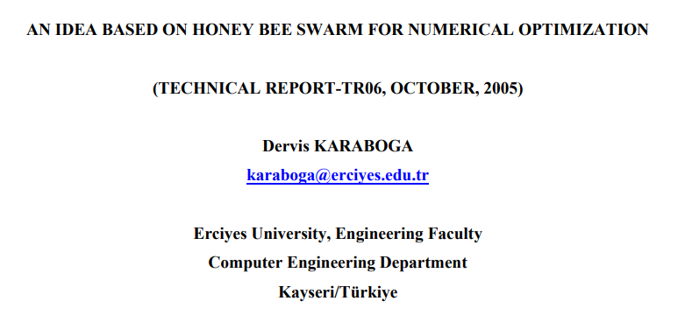
ABOUT ABC…
A Swarm intelligence algorithm, similar to ACO(ant), PSO(bird), using self-organization and division of labor, helping the Swarm adapts to the given environment.
4 ways the individuals reacts to each others: positive feedback, negative feedback, fluctuations, and multiple interactions
3 kinds of objects in simulation system: Food source, Employed bee, and Unemployed bee(scouts and onlooker bee).
Notes:
swarm intelligence as
“any attempt to design algorithms or distributed problem-solving devices inspired by the collective behavior of social insect colonies and other animal societies”

Slide 4
Division of Labor
01
02
03
Employed Bee
On-looker Bee
Scout Bee
Associated and search a particular food source, share this source with a certain probability.
(exploitation)
Choose a certain food source via probability and others bees’ information, then search the near location.
(exploitation)
When the certain food source is exhausted. The bees will search for new food source.
(exploration)

Slide 5
Procedure of ABC
Employed Bee Phase
On-looker Bee Phase
Scout Bee Phase
Selection Phase
Observe and search the certain food sources.
By fitness value, decide which food source to go.
When certain food source is exhausted, go scouting new sources.
calculate objectives, And update best gathering spot.

Slide 6

Iteration Procedure
Population: 4
Employed Ratio: 0.5
➔Employed Bee: 2
➔Onlookers Bee: 2
➔ Scarce limit: 2*dim/2

Slide 7
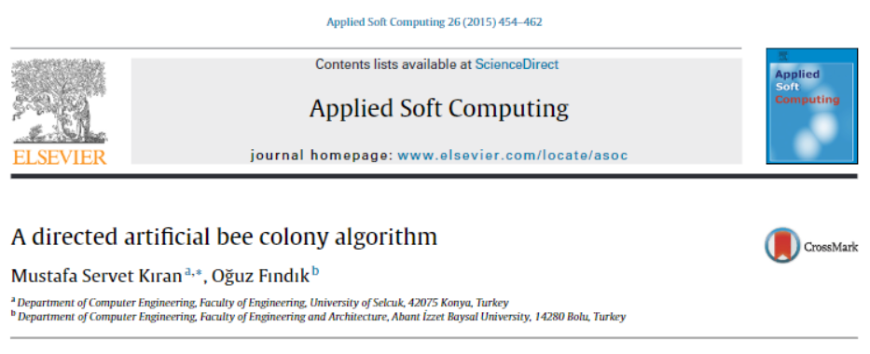
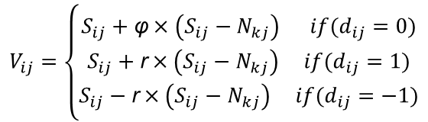
ABC vs. dABC.
Adding directional factor to improve original ABC randomly search for food source
S is artificial bee
N is food source location
d is a directional factor
r is a random number between [0, 1]
φ is a random number between [-1, 1]
$$V_{ij}=\left\{\begin{aligned}S_{ij}+\text{φ}×\left(S_{ij}−N_{kj}\right) if(d_{ij}=0) \\ S_{ij}+\text{r}×\left(S_{ij}−N_{kj}\right) if(d_{ij}=1) \\ S_{ij}−\text{r}×\left(S_{ij}−N_{kj}\right) if(d_{ij}=−1)\end{aligned}\right.$$

Slide 8
04
Benchmark Comparison.

Slide 9
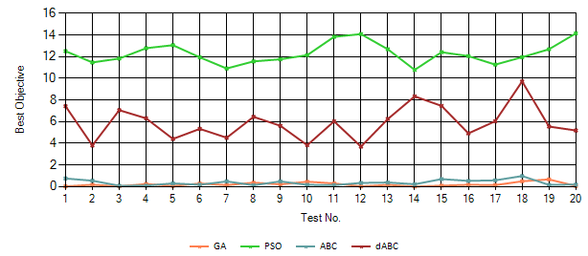
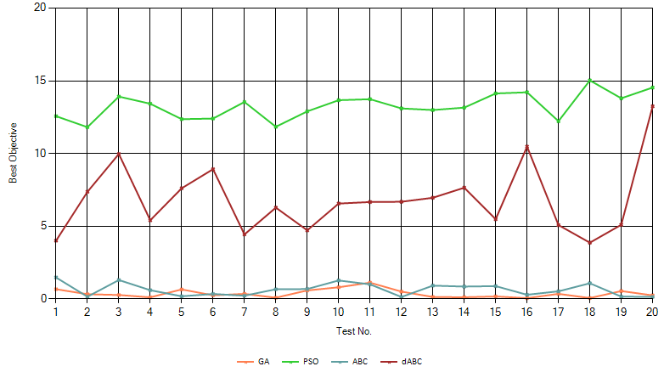
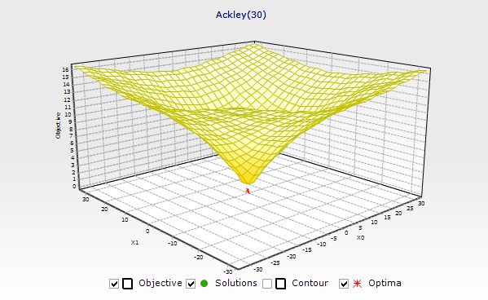
So far the best Comparison
 | Average | Deviation | Range | Median | Mode
GA | 0.377 | 0.286 | 1.065 | 0.306 | 0.062
PSO | 13.268 | 0.89 | 3.214 | 13.292 | 11.814
ABC | 0.651 | 0.436 | 1.342 | 0.641 | 0.141
dABC | 6.828 | 2.378 | 9.377 | 6.616 | 3.874
*Ackley(30), Iteration: 500, Number of agents: 20, Number of test: 20.

Slide 10
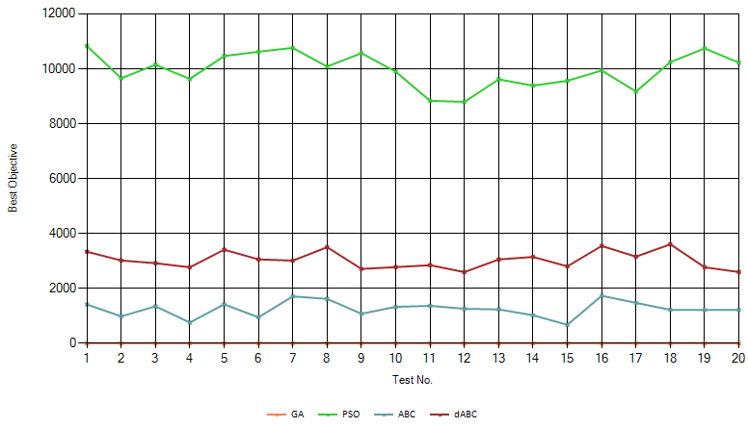
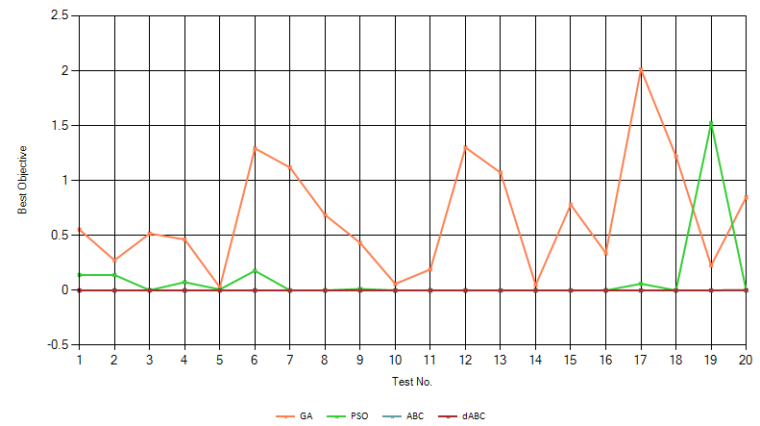
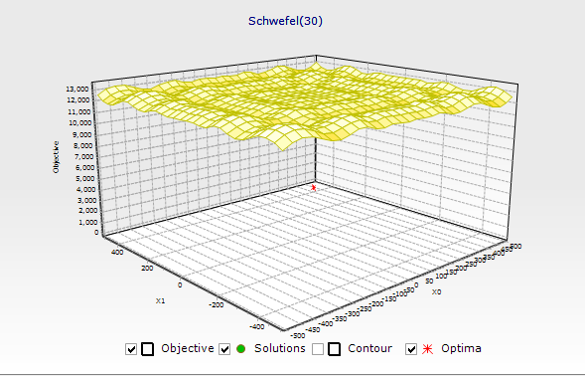
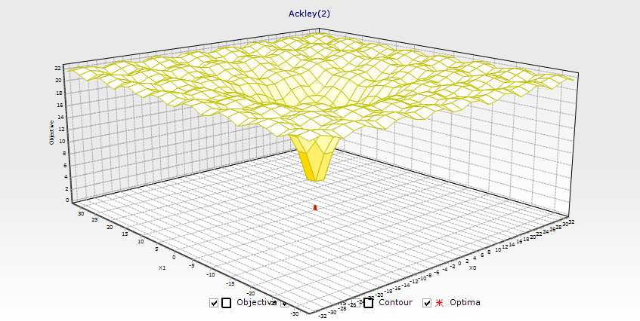
So far the best Comparison
 | Average | Deviation | Range | Median | Mode
GA | 0.674 | 0.528 | 1.986 | 0.536 | 0.028
PSO | 0.107 | 0.338 | 1.524 | 0 | 0
ABC | 0 | 0 | 0 | 0 | 0
dABC | 0 | 0.001 | 0.003 | 0 | 0
* Ackley(2), Iteration: 500, Number of agents: 20, Number of test: 20.

Slide 11
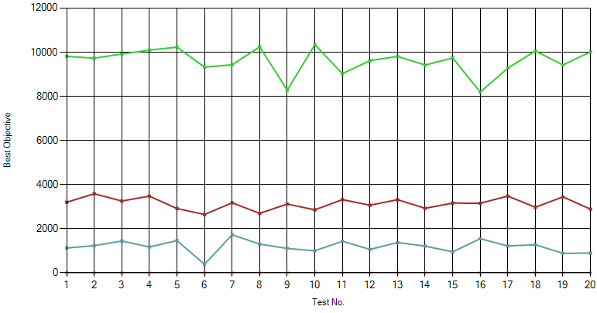
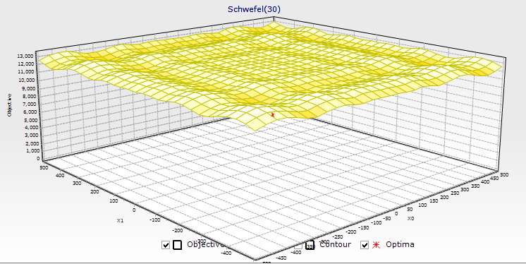
So far the best Comparison
 | Average | Deviation | Range | Median | Mode
GA | 0.821 | 0.816 | 3.208 | 0.578 | 0.086
PSO | 9601.432 | 586.52 | 2149.064 | 9737.351 | 8194.045
ABC | 1192.555 | 291.592 | 1341.866 | 1217.558 | 387.95
dABC | 3134.286 | 263.308 | 940.553 | 3159.387 | 2646.983
* Schwefe(30), Iteration: 500, Number of agents: 20, Number of test: 20.

Slide 12
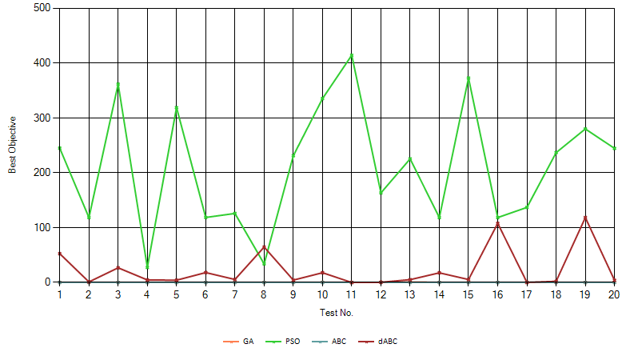
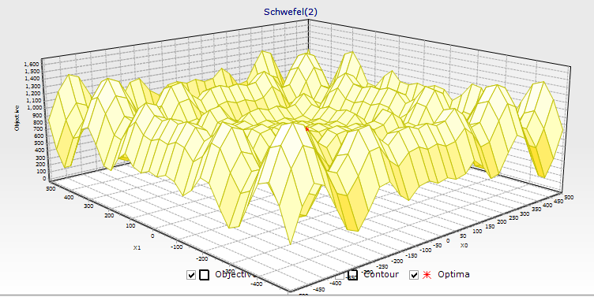
So far the best Comparison
 | Average | Deviation | Range | Median | Mode
GA | 0.146 | 0.156 | 0.707 | 0.105 | 0.008
PSO | 211.469 | 112.435 | 386.982 | 228.39 | 27.563
ABC | 0 | 0 | 0 | 0 | 0
dABC | 23.037 | 35.411 | 118.434 | 5.268 | 0.007
* Schwefe(2), Iteration: 500, Number of agents: 20, Number of test: 20.

Slide 13
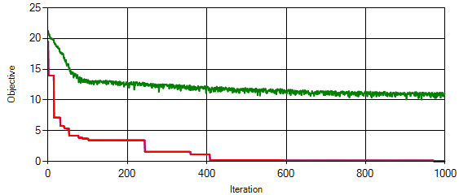
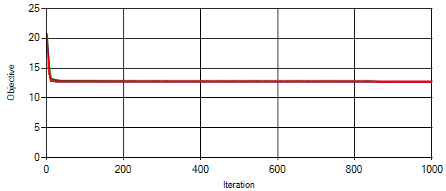
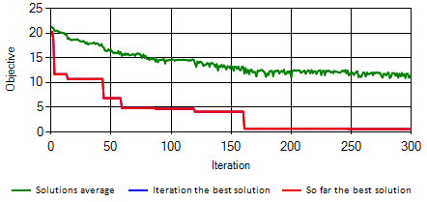
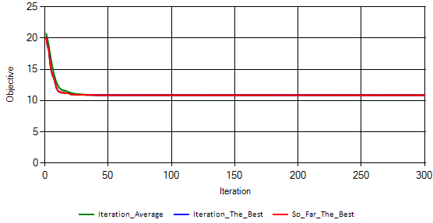
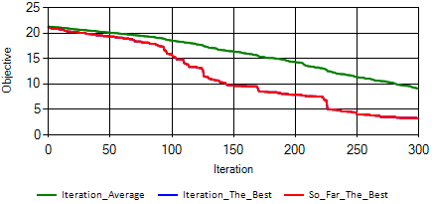
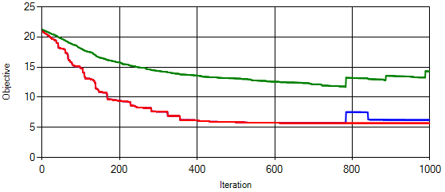
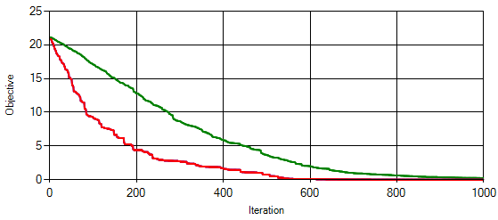
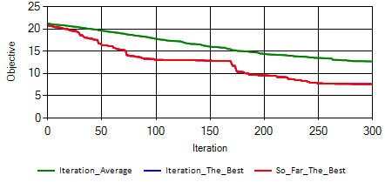
Stepping Function Comparison
GA (*0.042) | PSO (*12.73)
ABC (*0.001) | dABC (*5.705)
*Ackley(30), Iteration: 1000, Number of Agents: 20.
Notes:
f拓補

Slide 14
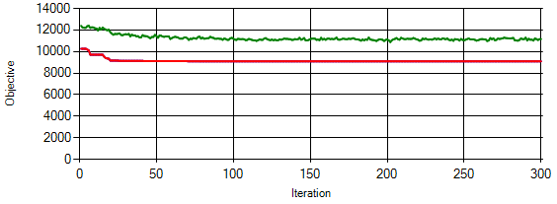
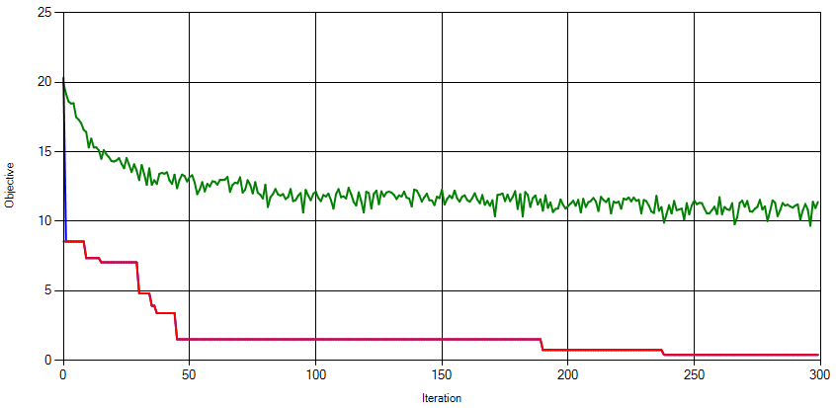
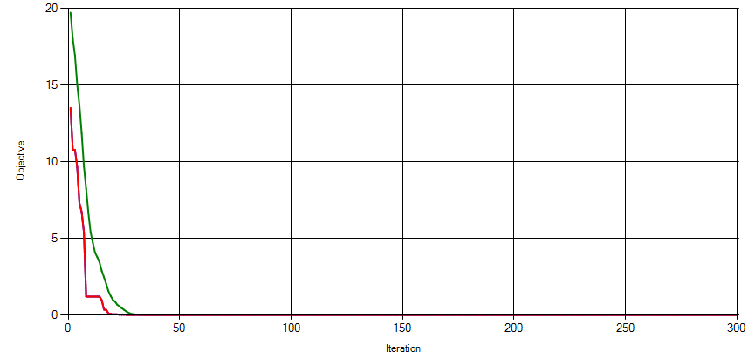
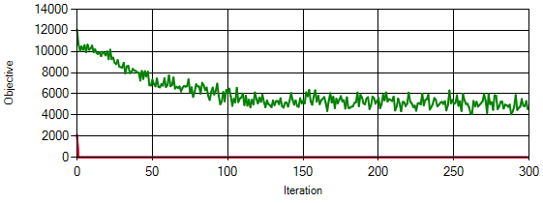
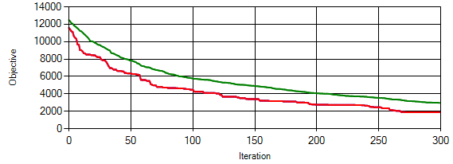
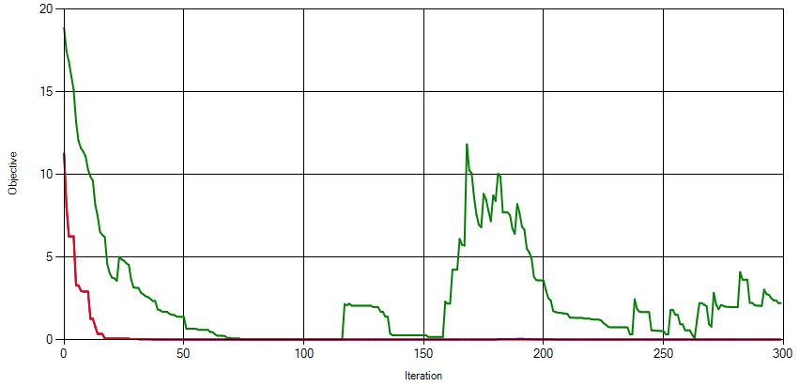
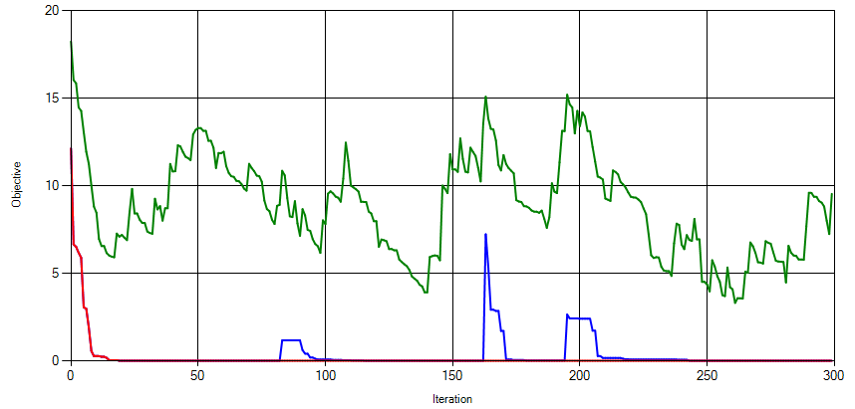
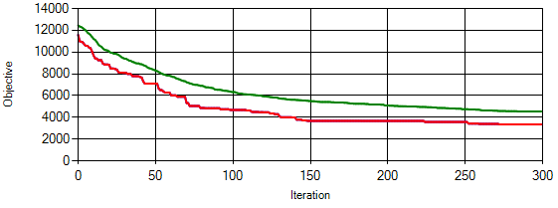
Stepping Function Comparison
GA (*0.094) | PSO (*0.001)
ABC (*0) | dABC (*0)
* Ackley(2), Iteration: 300, Number of Agents: 20.

Slide 15
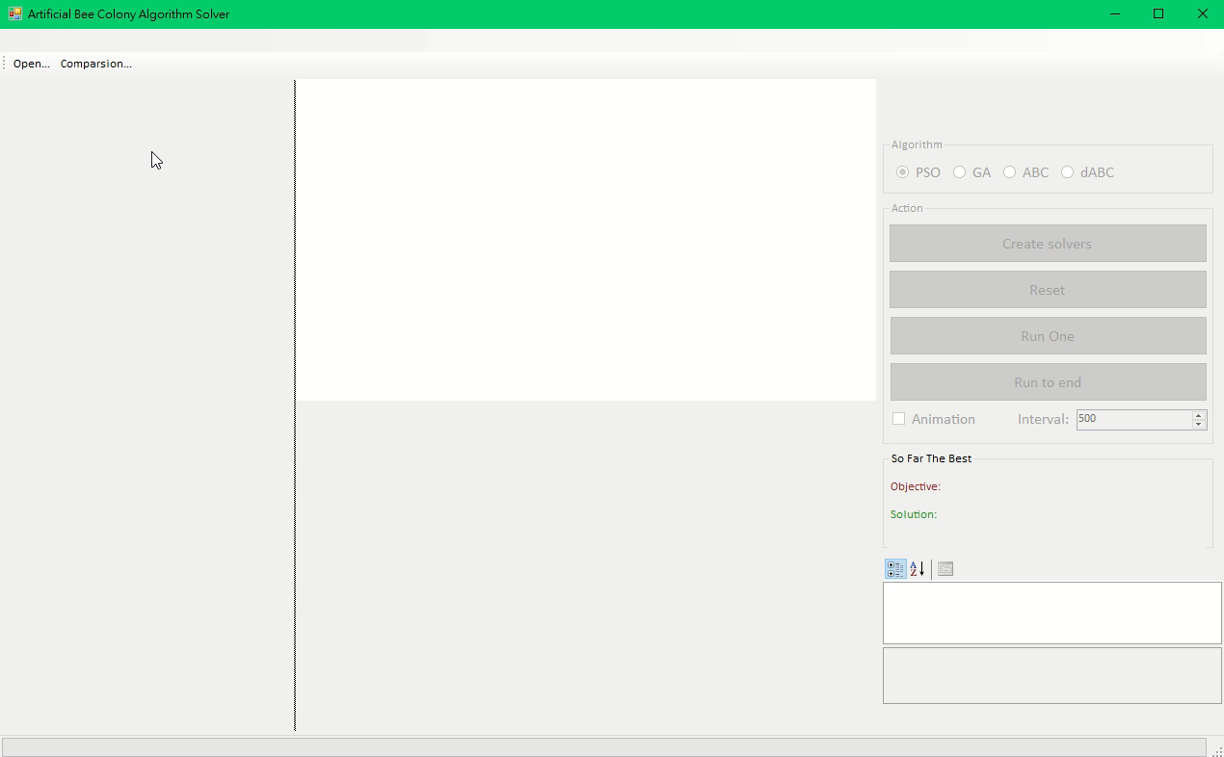
Demo Video

Slide 16
Conclusion
PSO ➔ Easily trap into local optimal solution, and effected much by initial solutions.
GA ➔ Powerful at high dimension problems. However, takes more time(or luck) to finds the global optimal, at low dimension scenario.
ABC ➔ Use fitness to highlight better solutions and perform more random search. Step out current solution when it’s too old. Competitive at low dimension search.
dABC ➔ Unfortunately can’t repeat the paper’s results at some benchmark problems. Maybe caused by parameters settings, or programming error.

